Slide 1

Deloitte Cloud Institute – Advanced DevOps learning program Kickoff deck
March 8th, 2021

Slide 2
Agenda
Introductions
Program Overview & Syllabus
Housekeeping items:
Booking time
Access to Udemy / LinkedIn
CURA overview

Slide 3

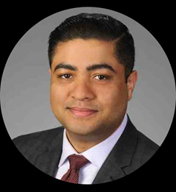
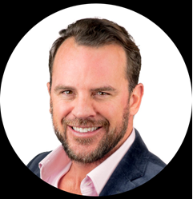
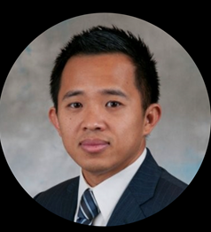
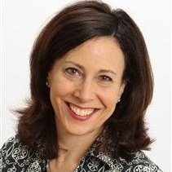
Program Offering Leadership
Thomas Skolik
Manager
Cloud Institute Lead
Kate Kustermann
Capability Development Lead Cloud SGO
Randeep Khaund
Senior Manager
DevOps Training Program Lead
Jason McDonald
Managing Director
DevOps Practice Lead
Bob Vuong
Principal
DevOps Practice Lead

Slide 4





Deloitte Cloud Institute: Creating a Cloud-Enabled Workforce
The Deloitte Cloud Institute offers a curated applied learning curriculum that couples deep technical training with business strategy, providing our practitioners with the breadth and depth required to succeed in a rapidly evolving market.
Learning Strategy
Multi-disciplinary Curriculum |  | Customized Applied Learning |  | Collaborative Approach
Combines deep technical training with business strategy to prepare practitioners for deployment on cross-functional teams Deep Tech: Technical expertise in prioritized platforms and tools Industry: How Cloud can address heart-of-business industry issues Delivery: Applying software delivery management capabilities (e.g., DevOps, design thinking) Strategy: Detailed grasp of the business strategy implications of Cloud Transformative Tech: How Cloud enables technology to transform our clients’ businesses (e.g., IoT, Blockchain) |  | Defined training pathways by role and competency level, creating a curated learning experience based on career model and interests, preparing practitioners to be part of agile teams |  | Dynamic approach drives collaboration and allows for content to be adapted based on changing market and learner needs Guided cohorts to facilitate community building and mentorship Formal feedback mechanisms for practitioners and leadership to quickly inform how content is adapted and consumed Cura platform Allows for collaboration with peers and SMEs/leadership Leverages machine learning to identify additional content based on interests
Mission
Agile Team
DEVELOPER
STRATEGIST
ENGINEER
ARCHITECT
AI / ANALYTICS
Multiple education and experience opportunities focused on applied learning to solve real client problems
Best-in class e-learning content
Hands on labs, case studies, and accelerators
On-the-job shadowing
Technology Guilds
A differentiated learning experience that provides our people the knowledge, experience, and path they need to elevate their Cloud capabilities and provide unparalleled services for our clients

Slide 5


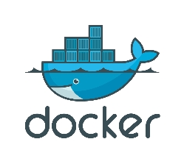



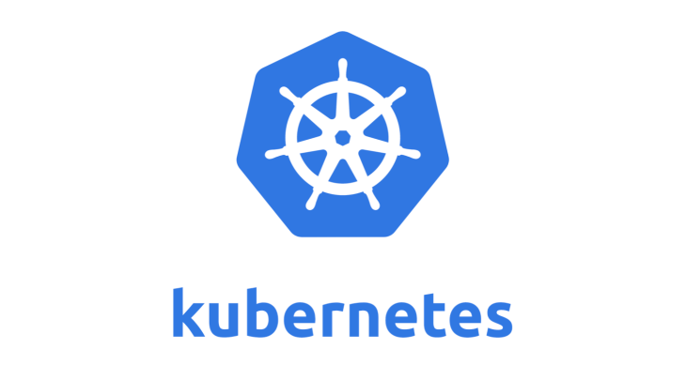

Advanced DevOps Learning Program
The DevOps learning program focusses on hands-on training that provides junior Deloitte practitioners the skills needed to become staff-able DevOps engineers. The program created by the Cloud DevOps Practice within Cloud Engineering, in partnership with the Cloud Institute but is offered across all offering portfolios.
Advanced DevOps Learning Program Overview
The Program enables practitioners with a deeper understanding of DevOps engineering, CI/CD practices and tools
Develop
Test
Deploy & Monitor
Build
Containerize
Pre-Work (Optional)
Bootcamp
Capstone Project
Industry Certification
Participants will be required to complete ~5 hours of online course content before the Bootcamp, if not already familiar with the prescribed content. The pre work includes:
Git Tutorial
GitHub Tutorial
Kubernetes Tutorial
Terraform Tutorial
Packer Tutorial
Participants attend a 4-day virtual training that provides hands-on immersion into DevOps engineering, practices, and tools in an interactive workshop / lab-based format
Participants will be trained on:
CI/CD pipelines in Jenkins
Containerization
Container deployment using Kubernetes
Infrastructure as Code tools
SRE techniques
Participants will be required to complete a take home ‘Capstone’ project. The project will involve many of the same tools and practices learned during the Bootcamp.
Upon completion, this project will be demoed to a learning coach who will determine if it meets sufficient criteria for passing. Participants are expected to complete the Capstone project within 4 weeks from the program start date
Participants will be required to complete obtain the Certified Kubernetes Application Developer (CKAD) certification after the bootcamp. Prior to taking the exam the participants will need to complete an online CKAD training course. Participants are expected to take the exam within 10 weeks of the cohort start date
Upon successful completion of the capstone project and the certification, participants will be badged as a Deloitte DevOps Engineer. This badge will show up against their profile in DPN

Slide 6

DevOps Learning Path
Program graduates can opt from one of the following four personas to move forward with their learning path; CI/CD Automation Engineer, Cloud DevOps Engineer, DevSecOps Engineer, or PaaS Platform Engineer (see following slides for a breakdown of each of these four personas).
Entry Criteria
Graduates of the Cloud Institute Foundational Cloud Developer program or CND Guild Mastery Program
Junior practitioners who have System admin and/or programming skills
Entry Criteria
Deloitte Engineers that already have the required a solid baseline of DevOps skills, and therefore do not need to go through the DevOps Bootcamp before pursing a persona.
DevOps Learning Program
DevOps Engineer Associate Architect or Developer Background
Pre Work
Bootcamp
Capstone Project
Industry Certification
Cloud Service Provider DevOps Professional Certifications
Multi-Cloud PaaS Certifications
Security Certifications
CI/CD Orchestration Certifications
Infrastructure-as-code and Configuration Management Certifications
Deloitte Focus Areas
Certified Jenkins Engineer or Cloudbees Certified Jenkins Engineer
Deloitte DevOps Cloud Platform (DCP)
AWS, GCP, or Azure Associate Architect or Developer certification
Certified Kubernetes Admin
AWS, GCP, or Azure security certifications
Iac: Hashicorp Certified Terraform Associate
Certified to Sell
GitLab CI/CD Specialist
Certified to Serve
AWS, GCP, or Azure DevOps Professional Certification
VMWare Tanzu Developer or Application Architect
CISSP
Config Mgt Certification
(select one):
RHCS in Ansible Automation
Chef
Puppet
Saltstack (SSCE)
Deloitte curated nano-degrees
Mentor support on skill development and learning
AWS, GCP, or Azure Architect Certification
RedHat Certified OpenShift Developer
HashiCorp Security Automation Certification
Implementation of Enterprise Patterns like Kubernetes deployment of a Kafka Cluster
Hashicorp Vault integration in CI/CD Toolchain
Automated DB deployment using Flyway/Liquibase in CI/CD Pipeline
Pick your Path: Diversify your DevOps skills by selecting a Persona to pursue after being badged as a DevOps Engineer

Slide 7
DevOps Bootcamp – Topics Covered each Day
The Bootcamp is a comprehensive 4-Day training program, and it focusses on enabling participants with key DevOps concepts and skills ranging from Source Code Management to Docker, Kubernetes and CI/CD
Day One
Day Two
Day Three
Day Four
DevOps Introduction
Application Lifecycle Management
Source Control
Package managers
Docker
Dockerizing applications
Kubernetes
Deploying to Kubernetes
Kubernetes continued
Kubernetes security
Infrastructure as code
CI/CD
CI/CD continued
Building CI/CD pipelines
Site Reliability Engineering
Defining SLO and SLI
Version management

Slide 8
Advanced DevOps Learning Program – Key Milestones
The learning program is a comprehensive training program with a 10-week curriculum. The program starts with a 4-day Bootcamp followed by a take-home Capstone project and an online course to help you prepare for the CKAD exam. During this entire process there would be learning coaches to guide you with your progress
Week | Week Of |  | Key Activity | Hours | Objectives
 | Mar 15th Cohort | Mar 22nd Cohort
0 | 8-Mar | 15-Mar | Pre Read/ Training | 1-5 | Participants will be provided pre read materials and links LinkedIn Learning & Udemy courses as a precursor to the DevOps Bootcamp
1 | 15-Mar - 18-Mar | 22-Mar – 25-Mar | Advanced DevOps bootcamp | 32 | 4 day in person bootcamp for DevOps Certified Engineer hands-on practice
2 | 22-Mar | 29-Mar | Begin Capstone Project | 10 - 15 | Participants will be required to complete a take home ‘Capstone’ project. The project will involve many of the same tools and practices learned during the Bootcamp.
5 | 12-April | 19-April | Setup demo sessions with your learning coaches for the Capstone Project | NA | Upon completion, this project will be demoed to a learning coach who will determine if it meets sufficient criteria for passing. Participants are expected to complete the Capstone project within 4 weeks from the program start date
6 | 19-April | 26 - April | Begin Certified Kubernetes Application Developer (CKAD) online course | 10 - 15 | Participants will begin a 10-hour Certified Kubernetes Application Developer (CKAD) course. The goal of this is to ensure participants are well prepared before taking the certification exam. Vouchers for the exam will be shared post sharing the course completion certificate
10 | 17-May | 24-May | Schedule dates and take the CKAD exam | NA | Participants will be getting exam vouchers and take/schedule the CKAD exam post completion of the online prep course. Once certified, they will receive an internal Deloitte DevOps Certified Engineer badge.
Denotes virtual instructor-led training

Slide 9
Weekly Office Hours with the Learning Coaches
As a part of the program, we will be assigning learning coaches to each participant to guide them through the program. The coaches are expected to setup recurring sessions with their coachee’s to make sure their progress is on track to complete the program milestones
Role of the Learning Coach
Agenda:
Follow up with your respective coachees on a regular basis and evaluate their projects and progress to ensure their development is on track
Help your respective coachees with technical guidance while they work on the Capstone project and the CKAD certification preparation
Share progress report of coaches on a weekly basis with the learning team to discuss the progress of their respective coachees. Coaches should also be notifying the learning team as and when their coachees
Complete program milestones
Run into any issues that will delay them in meeting program milestones
Share feedback with the Learning team in order to strengthen the program curriculum
Coachees are expected to setup time with their coaches on a weekly basis to track their progress
Half-hour every week
Focus on Capstone project progress
CKAD related questions
Coaches are expected to share their coachee’s progress with the Learning team on a weekly basis.
Learning coaches will send out invites for office hours
Meeting Expectations (Office hours and Bootcamps)
Be present and engaged
Maximize opportunity of interacting with dedicated learning coaches to understand real-world application of technical solutions

Slide 10
Questions? Contact your Learning Coaches
Jatin Jaiswal: jatjaiswal@deloitte.com
Kaushal Kumar: kaushakumar@deloitte.com
Venkat Pallem: vpallem@deloitte.com
Manjunath Bellad: mbellad@deloitte.com
Stefan Hodges: sthodges@deloitte.com
Chiranjeevi Chandrashekar: chichandrashekar@deloitte.com
Gerald Ruiz: gerruiz@deloitte.com

Slide 11
Housekeeping Items

Slide 12
Housekeeping (Advanced DevOps Learning Program)
Track all the time you spend on Cloud Institute online and live classes as well as any supplemental learning using your applicable CED code in Deloitte Time & Expense (DTE)
Complete program evaluations in a timely manner
CURA:
You’ll be utilizing the firm’s new learning & development curation system, known as CURA, to access the classes listed on the program syllabus. CURA is often referred to as “the Netflix of learning” because, like Netflix, the system uses machine learning to recommend content (from both internal and external sources) to you. As participants in this program, you will spend the majority of your time in CURA in our cohort group “hub” where all the classes are housed (in our Journey) and where you will be able to collaborate with your fellow cohort members.
Log-in to CURA using Single Sign On (SSO)/ Deloitte credentials
Create your CURA profile, keeping in mind that you’ll be using CURA for this program and beyond (throughout your whole career here at Deloitte) so you do not have to limit your profile set-up answers to the scope of this program
Save the CURA URL to your favorites
The majority of the classes in this program are from external sources, so upon accessing the classes in CURA, you will be routed to one of the 3rd party online, on-demand learning platforms we are leveraging, namely:
LinkedIn Learning
LinkedIn Learning (formerly Lynda.com) provides all kinds of business, technology, software video courses, comprised of bite-sized segments—keep in mind, as participants in this program, your first priority is to focus on completing the LinkedIn Learning classes as outlined in our CURA Journey
All Deloitte professionals have direct access to LinkedIn Learning; no need for separate log-in credentials

Slide 13
Housekeeping (cont.)
Udemy for Business
Like LinkedIn Learning, Udemy for Business offers a plethora of courses on business and technology topics. Again, as participants in this program, your first priority is to focus on completing the Udemy for Business classes as outlined in our CURA Journey
All Deloitte professionals have direct access to Udemy Learning; no need for separate log-in credentials
In Week 6 and 10 you will participate in virtual live classroom training, which will require Zoom and your attendance is mandatory:
You need a headset and a webcam
The webcam must be turned on during the entire session
Charge your time using your specific CED code (“CEDXXXXX-01-01-01-0000”, where XXXXX is your cost center).

Slide 14
Housekeeping (Advanced DevOps Learning Program)
Track all the time you spend on Cloud Institute online and live classes as well as any supplemental learning using your applicable CED code in Deloitte Time & Expense (DTE)
Complete program evaluations in a timely manner
CURA:
You’ll be utilizing the firm’s new learning & development curation system, known as CURA, to access the classes listed on the program syllabus. CURA is often referred to as “the Netflix of learning” because, like Netflix, the system uses machine learning to recommend content (from both internal and external sources) to you. As participants in this program, you will spend the majority of your time in CURA in our cohort group “hub” where all the classes are housed (in our Journey) and where you will be able to collaborate with your fellow cohort members.
Log-in to CURA using Single Sign On (SSO)/ Deloitte credentials
Create your CURA profile, keeping in mind that you’ll be using CURA for this program and beyond (throughout your whole career here at Deloitte) so you do not have to limit your profile set-up answers to the scope of this program
Save the CURA URL to your favorites
The majority of the classes in this program are from external sources, so upon accessing the classes in CURA, you will be routed to one of the 3rd party online, on-demand learning platforms we are leveraging, namely:
LinkedIn Learning
LinkedIn Learning (formerly Lynda.com) provides all kinds of business, technology, software video courses, comprised of bite-sized segments—keep in mind, as participants in this program, your first priority is to focus on completing the LinkedIn Learning classes as outlined in our CURA Journey
All Deloitte professionals have direct access to LinkedIn Learning; no need for separate log-in credentials

Slide 15
Housekeeping (cont.)
Udemy for Business
Like LinkedIn Learning, Udemy for Business offers a plethora of courses on business and technology topics. Again, as participants in this program, your first priority is to focus on completing the Udemy for Business classes as outlined in our CURA Journey
All Deloitte professionals have direct access to Udemy Learning; no need for separate log-in credentials
In Week 6 and 10 you will participate in virtual live classroom training, which will require Zoom and your attendance is mandatory:
You need a headset and a webcam
The webcam must be turned on during the entire session
Charge your time using your specific CED code (“CEDXXXXX-01-01-01-0000”, where XXXXX is your cost center).

Slide 16
CURA

Slide 17
CURA – A Quick Primer
Consume
Collaborate
Create

Slide 18
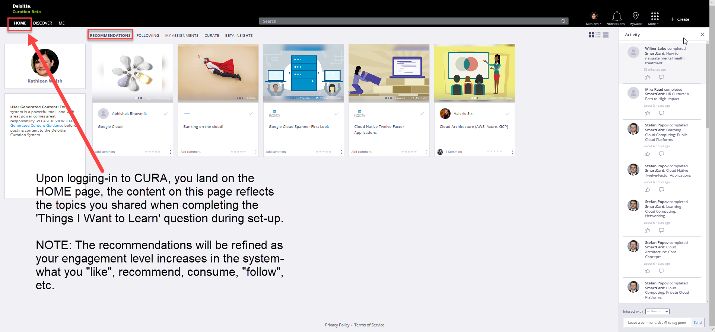
CURA – A Quick Primer

Slide 19
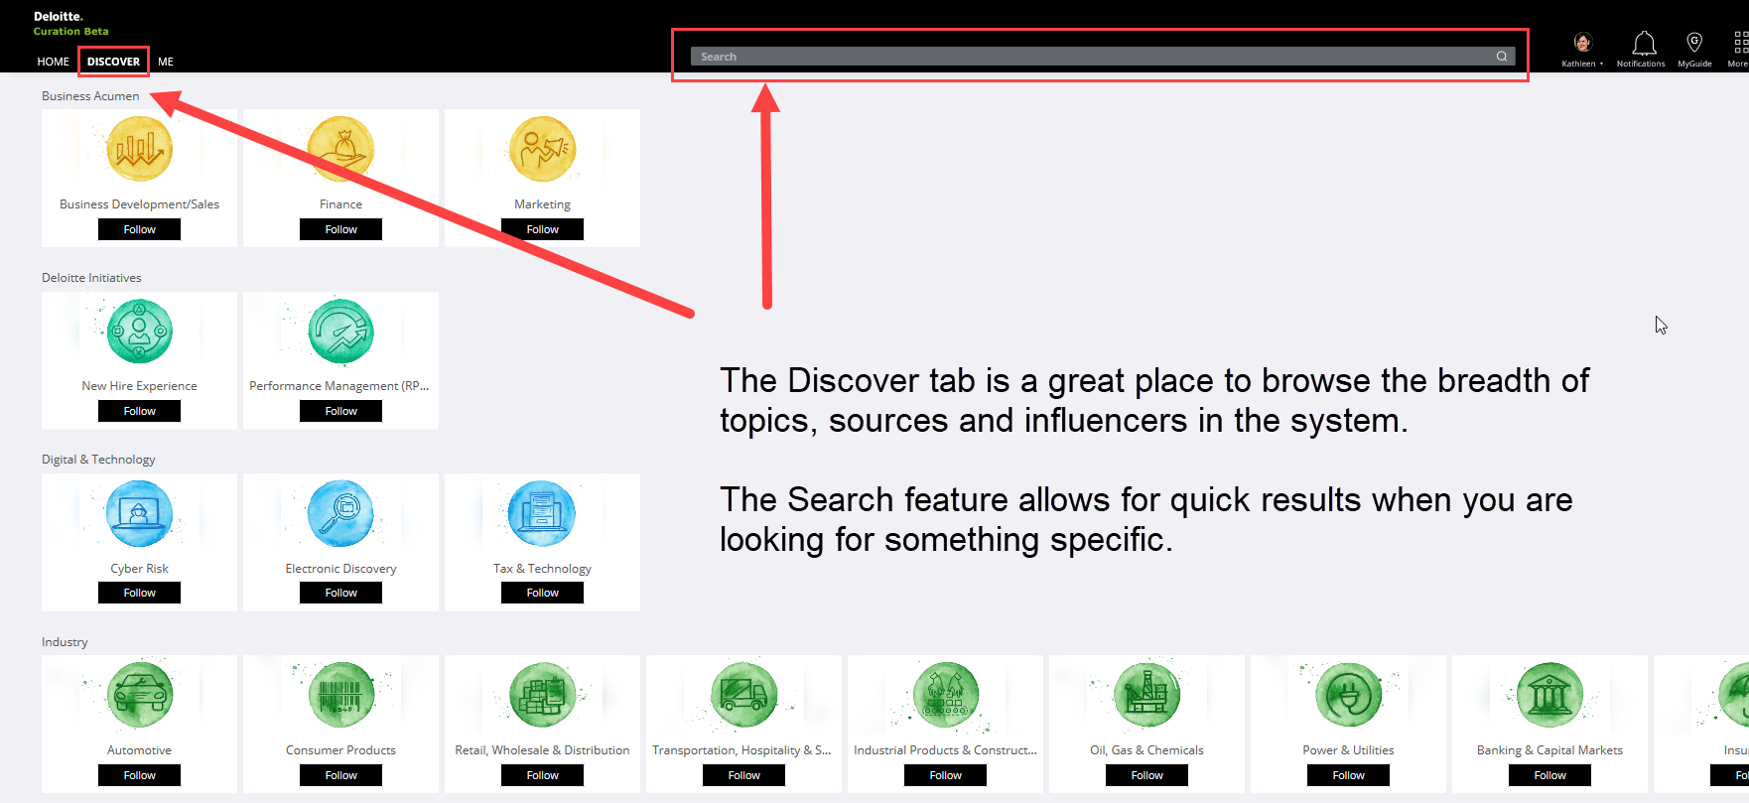
CURA – A Quick Primer

Slide 20
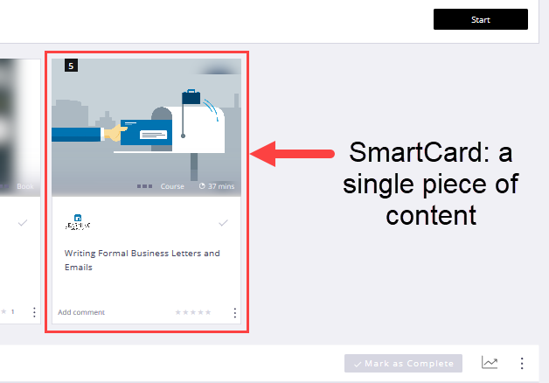
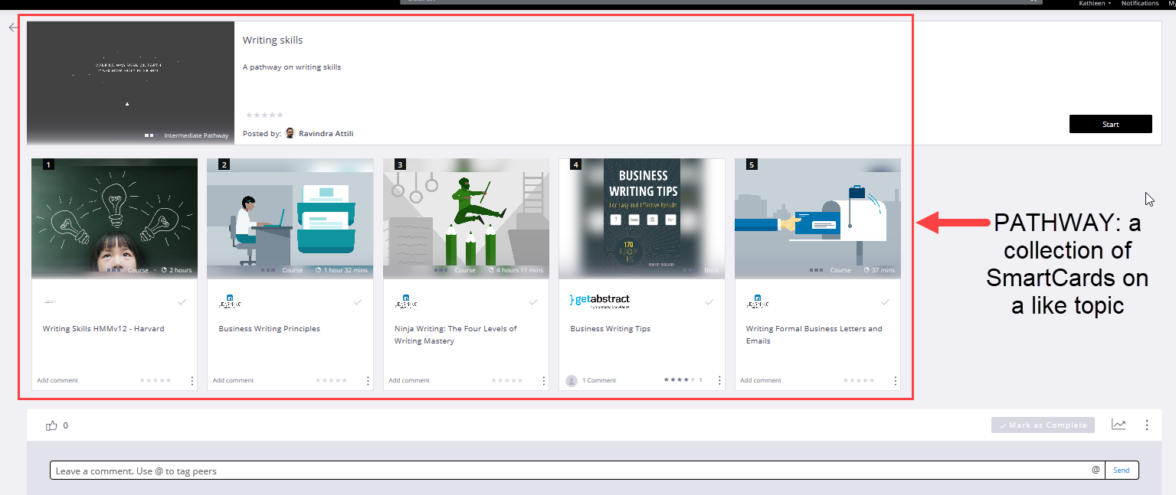
CURA – A Quick Primer

Slide 21
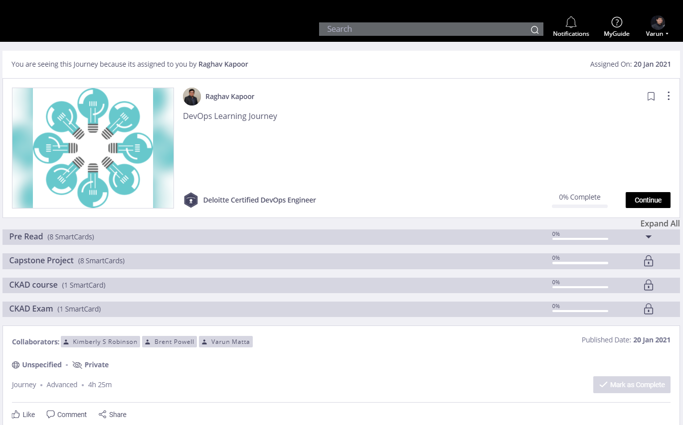
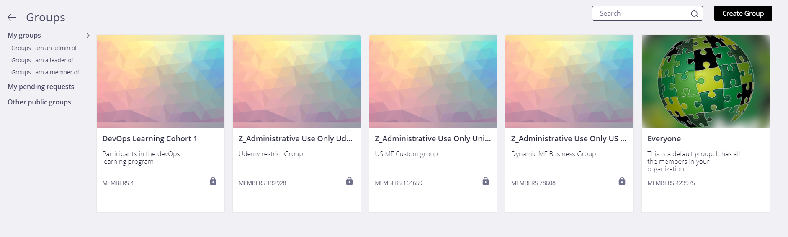
CURA – A Quick Primer
Journey: Similar to pathways, Smart Cards are bucketed into sections that must be consumed in a specified sequence and/or timeframe
Group: a cohort of learners with which Smartcards, Pathways & Journeys can be shared

Slide 22
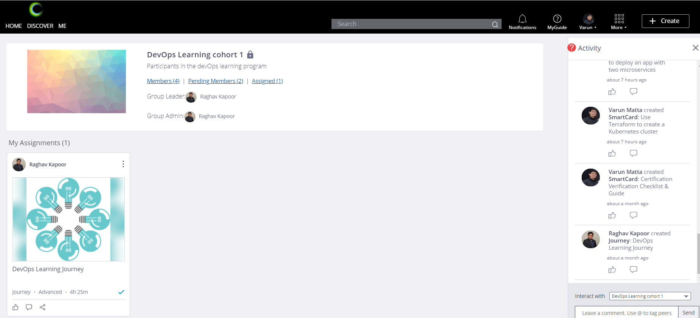
CURA – Your Cohort Group Hub

Slide 23
CURA – Navigating to access your learning materials
This journey is an online, on–demand version of your program syllabus (your Learning Pathway)
Expand each week to access and launch the required training assignments in the recommended timeframe
Feel free to Start Today and follow your own pace!
Content is organized in ‘buckets or sections which reflect the sequence and time frame in which Cloud Institute recommends the content to be consumed

Slide 24
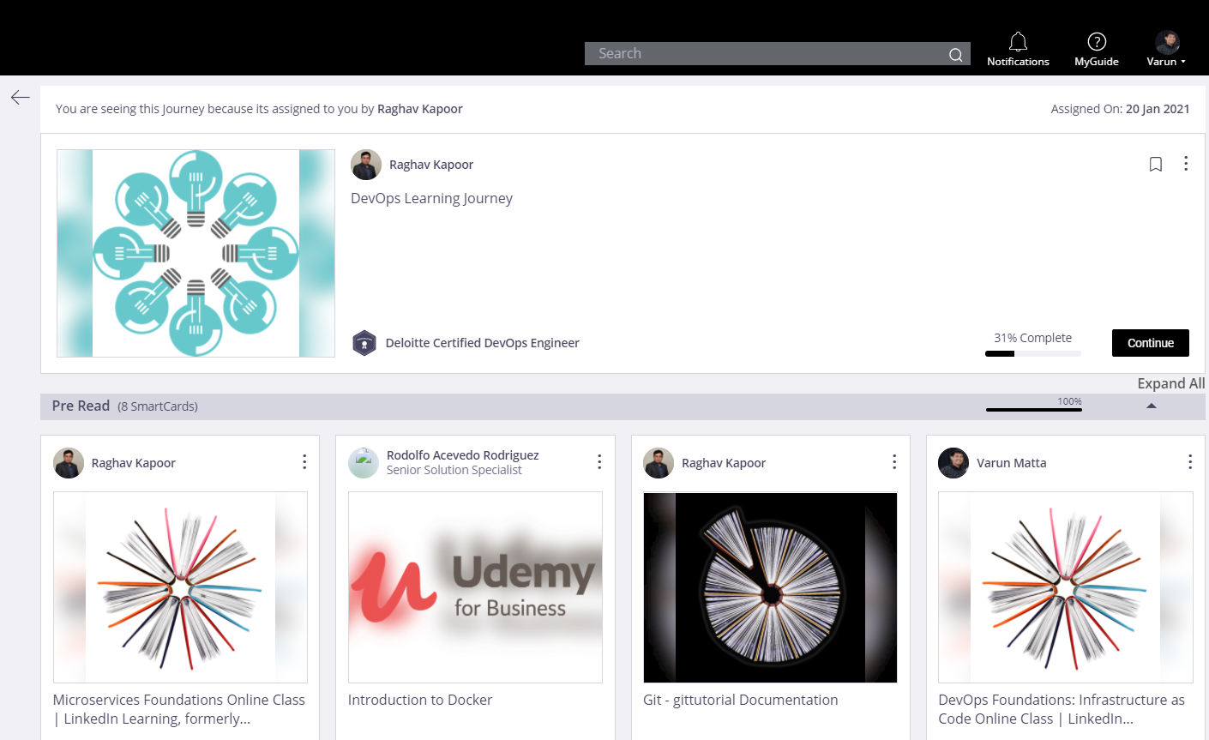
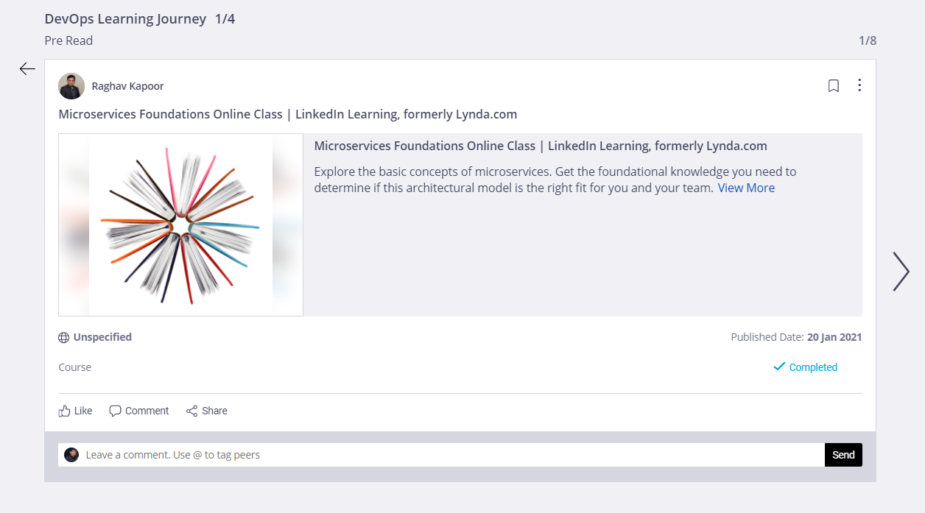
CURA – Accessing your learning materials
You will see a brief description of the course
This is your first course of Week 1: Pre Read!
Depending on the course, click on the image or the link on the description to access the content
You will be taken out of CURA into the Learning Platform (e.g., Udemy)
Once you are done consuming the content, come back to CURA to continue your learning!

Slide 25
FAQ

Slide 26
Q: How was I nominated for this course?
A: Learners are nominated for the Deloitte Cloud Institute by their Talent Group Leader(s). Professional development is an integral part of Deloitte’s continuous learning environment. This opportunity will allow you to receive a certification from one of the major Cloud vendors.*
Q: Do I need prior experience in Cloud/DevOps, or is this truly a foundational course to build that knowledge?
A: This training is foundational. No prior knowledge or experience is required.
Q: I am unable to attend the virtual bootcamp(s), can I still complete the cohort?
A: The bootcamps are required in order to successfully complete the program. If the dates of the bootcamps conflict with urgent client needs or a personal emergency arises, please reach out to the Cloud Institute Team for further assistance.
*The Azure bootcamp is for 4 days from Mar 23 – Mar 26

Slide 27
Q: How do I find the correct courses in Cura?
A: After the kickoff call you will receive a deck all of the necessary links to the courses.
Q: Where do I charge my time?
A: Time spent for the Cloud Institute should be charged to CEDXXXXX-01-01-01-0000. The XXXXX is your cost center.
Q: Who pays for the exam?
A: All Cloud Institute learners will receive a voucher – with no cost to them.
Q: Can I request a voucher for the exam?
A: Cloud Institute cohort participants will be provided a voucher in Week 9 or 10 depending upon their progress and post discussion with the learning coaches. Learners should not purchase a voucher themselves. (Foundational)
Q: If I do not pass the exam, can I retake it?
A: If you are unsuccessful on your first attempt, we will collect feedback to help us better understand participant challenges and suggest additional exam prep materials. At that point, the Cloud Institute team can provide a new voucher.

Slide 28
My Certifications – Talent on Demand

Slide 29
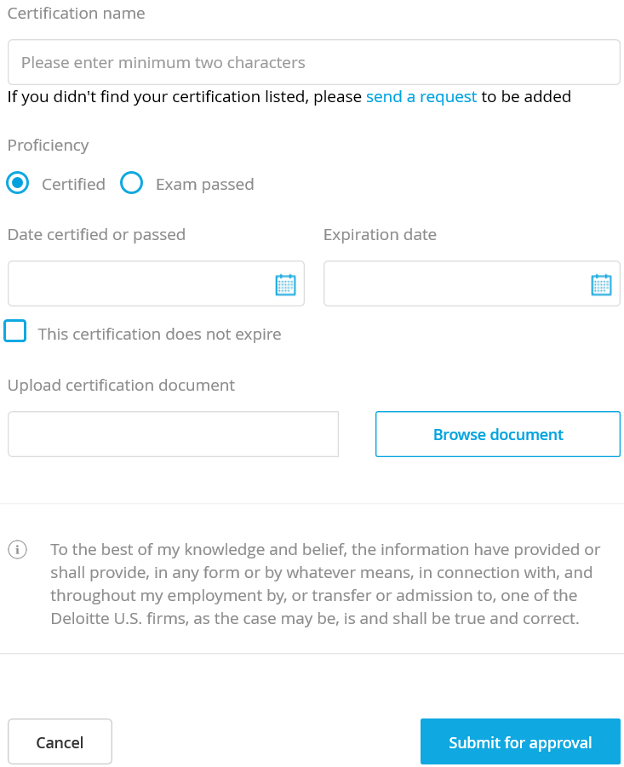
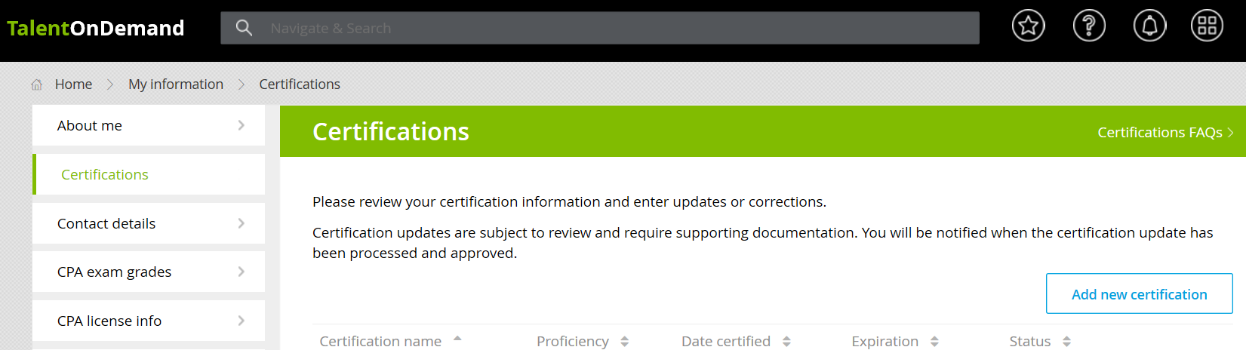
My Certifications – Talent on Demand
3
Fill Out Certification Details
1
Search for My Certifications - Talent on Demand in DeloitteNet Home Page
My Certifications
2
Click Add New Certification
4
Upload Certification
Click
5
Click

